Slide 1
PKI and Beyond: Wrapping Up Authentication: Part I
15-421/08-731 and 08-761/46-861 -- Fall 2013 – Lecture 5
Information Security & Privacy
Norman M. Sadeh
School of Computer Science
Carnegie Mellon University

Slide 2
Practical Info
Team Project Proposals: due by 5pm today
Project presentations: now finalized & updated syllabi available on BB
Homework Assignment #1 due by Sept 22

Slide 3
Overview
Brief recap of previous lecture
Authentication: Part I
References

Slide 4
Previous lecture
Digital Signatures
Certificates
PKI
Key Life Cycle Management
Export control

Slide 5
Public Key Infrastructure (PKI)
A collection of technologies/services and policies for creating and using digital certificates
Last lecture:
Public Key Certificates
Certificate Issuance
Certificate Distribution
Certificate Revocation

Slide 6

Simple Public Key Certificate
Certificate
Certification
Authority’s
Private Key
Subject Identification
Information
Public Key
Generate
Digital Signature
Certification Authority’s
Name
Certification Authority’s
Digital Signature

Slide 7
X.509 Certificate Format – v.2
Version of Certificate Format
Serial Number – unique ID number
Signature Algorithm Identifier – for CA’s signature
Issuer (CA) – X.500 Name
Validity Period – start & end
Subject – X.500 Name
Subject Public Key Info:
Algorithm Identifier
Public Key Value
Issuer Unique Identifier – optional (not X.500 name)
Subject Unique Identifier – optional (not X.500 name)
CA’s digital signature - input: all the above
v3: introduces extension fields

Slide 8
Types of Certificates
Certification Authority Certificate
Self-signed – also cross-certification
Server Certificate
Public key of an SSL server, name of organization running the server, DNS name of server
Personal Certificate
Individual’s public key, name, as well as other attributes
e.g. email address, postal address, birthday, etc.
e.g. employees of a company, bank customers, etc.
Software Publisher Certificate
To verify signatures on software (e.g. Android developer certificates)
Lots of possible uses in the future
To prove facts rather than identity
e.g. age, legal privileges, access rights, membership, etc.

Slide 9
Challenge
Certification Path must be found and validated
Certification path will generally traverse multiple CAs
From the public key to be validated to a trust anchor, whose public key is already held (and trusted) by the certificate user

Slide 10
Ideally:
Interoperation of separately established PKIs that implement different policies
Construction of complex PKIs capable of supporting applications with different policy demands
Two key challenges:
Certification path discovery
Certification path validation

Slide 11
Certification Path Discovery
Trust
Anchor
Trust
Anchor
Target
User
Trust
Anchor
This requires either one of two PKI services:
Given a CA’s name, get all the certificates issued to that CA by other CAs – can then work backwards until reach a trust anchor
Given a CA, get all the certificates issued by that CA to other CAs – can then work forward from each trust anchor

Slide 12
Certification Path Validation
Verify the digital signature of each certificate
Check that the subject of each certificate is correct
Check validity periods
Make sure each certificate has not been revoked
Check certificate policies
Check name constraints (namely restrictions imposed by one CA on certificates issued by a CA whose certificate it has signed)
This entire process has to be conducted securely

Slide 13
Certificate Management Protocols
Many suppliers of PKI products and many applications relying on PKI
Need for standards that provide for interoperability across multiple PKI products and applications, e.g.
Message to request issuance of a certificate from a CA
Message to deliver certificates
Unfortunately, this space remains fragmented – lack of interoperability

Slide 14
Minimal Disclosure Certificates
Personal certificates with a lot of info represent a potential threat to user privacy
Multipurpose certificates
Alternative: many single-purpose certificates
Difficult – e.g. certificates could be passed around if they didn’t include their user’s name
e.g. “This person is over 21”
Possible solution: minimal disclosure certificates
Selectively disclose just what is needed with the same certificate

Slide 15
Decentralized Trust Mgmt: Complexity of PKI
Steps involved in processing a request to access an application by a certificate holder:
Obtain requester certificate, verify signatures on certif and applic request, determine public key of original signer
Check that certificates are unrevoked
Look for trust path
Extract names from certificates
Lookup names in DB to check if allowed to perform requested action
Determine whether action is legal based on names and chain of policies
Execute requested action – if everything is OK
Observation: Steps 5 and 6 are application-specific: PKI does not explicitly help with this

Slide 16
Decentralized Trust Mgmt: A More Direct Approach
Use local trust management engines that can evaluate requests based on:
Certificates and description of local policy – both expressed in the same language
Simplified process:
Obtain certificates, verify signatures on certif and applic request, determine public key of original signer
Check that certificates are unrevoked
Submit request, certificates and description of local policy to local “trust management engine”
Proceed if approved
Moving away from credentials that bind identities to keys
Instead credentials are directly used to prove that one is authorized to use a service

Slide 17
Decentralized Trust Management
Formulating security policies and security credentials
Determining whether particular sets of credentials meet relevant policies
Deferring/Delegating trust to third parties
Motivation
PKI and PGP only address a narrow subset of the above - mainly with a view towards authentication
Decentralized Trust Mgmt: Solve this problem generally – application-independent solutions
History
Early work in 1995: Blaze & Feigenbaum
PolicyMaker and later KeyNote
Term coined in 1996

Slide 18
Motivating Example – Electronic Banking
A bank requires that loans of $1M or less be approved by at least k bank officers
Issue credentials that allow bank employees to prove that they can be counted as 1 out of k approvers
Bank has to be able to specify who can issue these credentials (trust relationship/delegation) – e.g. Human Resources
“Role-Based Access Control” (RBAC)

Slide 19
General Principles
Unified Mechanism: Common “safe” language for describing policies, credentials and relationships
Objective: handle security in a comprehensive, consistent and transparent manner
Flexibility: Expressively rich enough to support complex trust relationships
e.g. conditions for being allowed to issue certain types of credentials
Locality of Control: Each party decides which credentials to accept and who to trust
No monolithic hierarchy of CAs
Separation of Mechanism from Policy: Mechanism for verifying credentials does not depend on the credentials themselves or the semantics of the applications that use them – language is “orthogonal”

Slide 20
Distributed/Decentralized Policies
In a simplistic world, all policies would be in one place and specified by a single entity
More often, different parts of a policy come from different places
Delegation of authorization
e.g. CMU allows me to decide who enters my office
Different administrators for different services
Meeting room reservation, projector reservation
Multiple requirements for access
e.g. valid credit card & driver’s license

Slide 21
eXtensible Access Control Markup Language
XACML – XML-based standard developed by OASIS (1st version in 2003)
Policy language and architecture for secure access to enterprise resources by employees, partners and customers

Slide 22
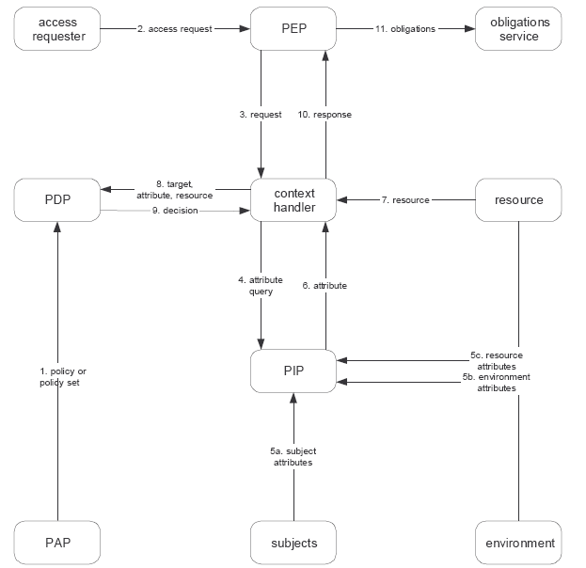
XACML – Data Flow Model

Slide 23
Scenario 1 (inspired by Grey)
Alice
Alice’s door
Open the Door
Signed: Alice

Slide 24
Scenario 2 (inspired by Grey)
Alice
Alice’s door
Bob can open the door
Signed: Alice
Bob
Open the Door
Bob can open the door
Signed: Bob
Signed: Alice

Slide 25
Scenario 3 (inspired by Grey)
Rachel is in charge of my door
Rachel
Alice
Signed: Alice
Alice’s door
Bob can open the door
Signed: Rachel
Bob
Bob can open the door
Rachel is in charge of my door
Open the Door
Signed: Bob
Signed: Rachel
Signed: Alice

Slide 26
References for this Part of the Lecture
Required Reading:
S. Garfinkel, “Web Commerce, Security and Privacy”, O’Reilly, 2nd edition, Ch. 7.
Optional Readings
Blaze, Feigenbaum, Lacy, “Decentralized trust Management”, IEEE Conf on Security & Privacy, 1996 – available at http://www1.cs.columbia.edu/~angelos/keynote.html
Introduction to XACML, http://dev2dev.bea.com/pub/a/2004/02/xacml.html
Grey system: https://www.ece.cmu.edu/~lbauer/papers/2005/isc2005-grey.pdf and more generally: http://www.ece.cmu.edu/~grey/

Slide 27
Authentication & Security Protocols: Technical, Business & Human Issues

Slide 28
Overview
Authentication Fundamentals
Password and PINs
Next Lecture: Authentication: A Deeper Dive

Slide 29
Authentication
Making sure people or things (e.g. a server) are who they claim to be
Terminology:
Principal: Legitimate owner of a given identity
Claimant: Entity attempting to be authenticated as a principal

Slide 30
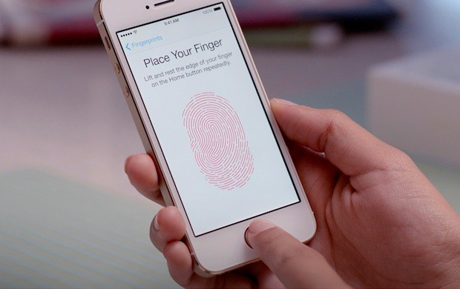
iPhone 5S: Fingerprint Touch-ID
Is this a positive development?
Why? Why Not?
Any reservations?

Slide 31
Question
What approaches do we have available to verify someone’s identity?

Slide 32
Authentication Factors
Claimant demonstrates knowledge of something
e.g. Password
Claimant demonstrates possession of something
e.g. a smart card
Claimant exhibits some required (immutable) characteristics
e.g. retinal scan, fingerprint, etc.
Claimant provides evidence that (s)he is at a particular place (or network address)
e.g. fixed phone number
Claimant provides proof that (s)he has been authenticated by a trusted third party
e.g. Kerberos, ADFS, OpenID, etc.

Slide 33
Can You Defeat Some/All of These Approaches?
Claimant demonstrates knowledge of something
Claimant demonstrates possession of something
Claimant exhibits some required (immutable) characteristics
Claimant provides evidence that (s)he is at a particular place (or network address)
Claimant provides proof that (s)he has been authenticated by a trusted third party

Slide 34
Authentication Factors
Reliance on a single factor is often insufficient
Multifactor authentication generally offers greater levels of certainty

Slide 35
Unilateral vs. Mutual Authentication
Unilateral Authentication: Just one party to a communication activity authenticates the other
e.g. Typical credit card payment over SSL/TLS: server authentication only
Mutual Authentication:
Both parties authenticate each other

Slide 36
Passwords and PINs
Almost all personal authentication schemes depend on passwords to some extent
Major threats:
External disclosure
Guessing
Communications eavesdropping
Replay
Host compromise
Forgetting

Slide 37
Elements of Authentication Protocols - I
Question: How do you protect your password against eavesdropping?
Transformed password:
Process password presented by user with a one-way function (in the client)
Similar operation is performed by the server
Question: Is this enough?

Slide 38
Elements of Authentication Protocols - II
Question: How do you protect your password against replay attacks?
Challenge Response:
Server sends random value (“challenge” or “nonce”) to client
Client incorporates this value into its response
e.g. As additional input to one-way password transformation function
Server carries out the same computation & compares the result with the response received from the client
Now we also have Replay Protection

Slide 39
Elements of Authentication Protocols - III
Time Stamp:
e.g. include time stamp as additional input to one-way password transformation function
Replay protection – though more limited than challenge/response
Assumes that client and server have secure synchronized clocks

Slide 40
Elements of Authentication Protocols - IV
One-time passwords:
e.g. Process password n times through one-way function & decrement n at each new login
Server keeps track of value of n
Replay protection w/o challenge-response

Slide 41
Elements of Authentication Protocols - V
Digital Signature
Client proves possession of its private key by signing a message
Replay protection: include time stamp and/or challenge value in message
Zero Knowledge Techniques: Possession of information is proved without any part of the information being revealed
Requires more complex data exchange protocol
Higher bandwidth requirements but possibly lighter computational requirements
e.g. graph isomorphism

Slide 42
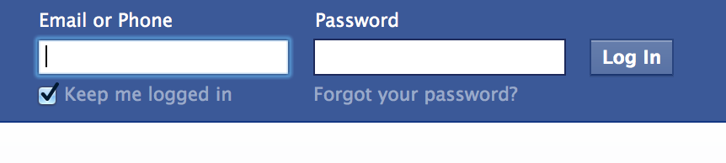
Password Cracking: Online Attack
Attacker guesses password at login screen
Thwarted by lockout, timeouts, captchas

Slide 43
Offline Attack
Attackers steal password file from server
If the passwords are not hashed, the attacker now has all of the passwords!
Even if the passwords are hashed, the attacker can crack them at his leisure

Slide 44

Offline attacks in the past two years
Past two years | Victims
Gawker | 1,300,000
Sony | 25,000,000
Battlefield Heroes | 550,000
Sega | 1,300,000
Booz Allen Hamilton | 90,000
Bloggtoppen | 90,000
Valve | 700,000
LinkedIn | 6,500,000
Compiled by Saranga Komanduri

Slide 45
What can organizations do?
Encourage strong passwords
Hash and salt passwords

Slide 46
Password-Composition Policies
Offline attacks are much harder to thwart, since the attacker can make billions of guesses against a system
“John the Ripper” software to crack passwords – brute force mode, dictionary attack mode, etc.
This is why password-composition policies try to guide users towards harder-to-break passwords
Traditionally, people have measured “password strength” based on “entropy”
This metric ignores human/usability considerations

Slide 47
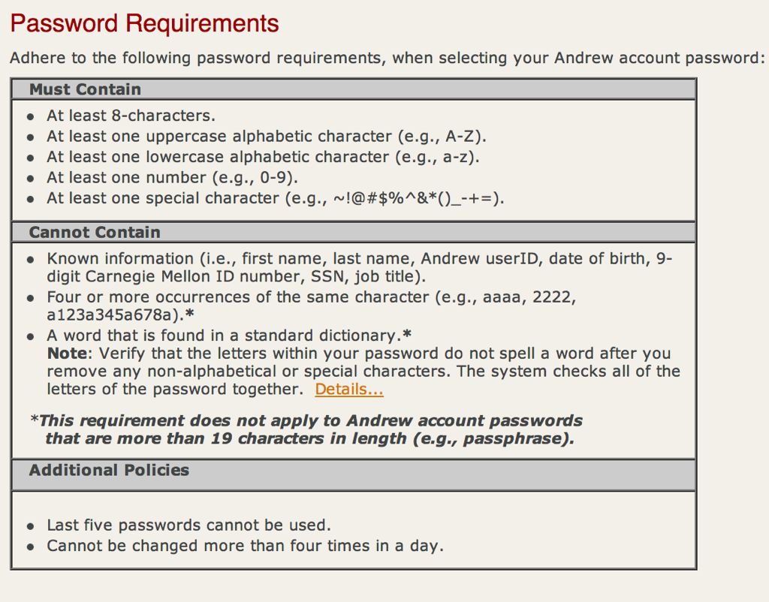

Slide 48
Common Passwords
Most common passwords from stolen set of RockYou passwords. Posted by Matt Weir at reusablesec.blogspot.com
123456
12345
123456789
password
iloveyou
princess
1234567

Slide 49
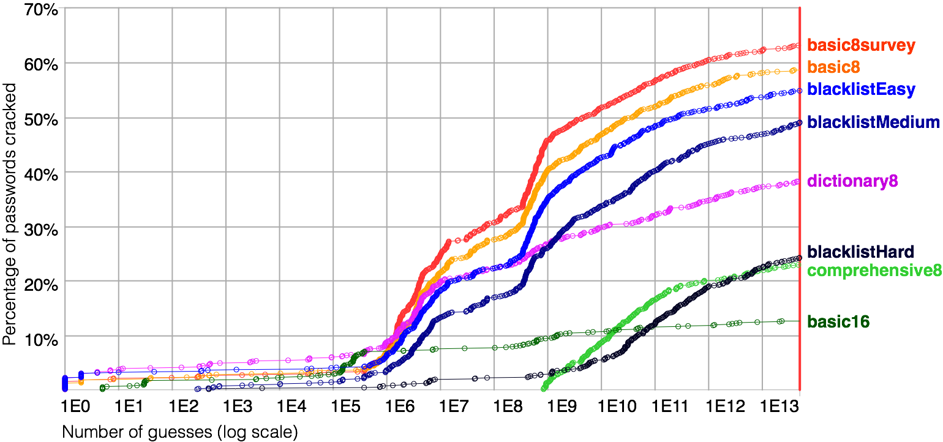
Best Practice Recommendations Debunked
From Guess Again (and again and again): Measuring password strength by simulating password-cracking algorithms. Oakland 2012. (Patrick Gage Kelley, Saranga Komanduri, Michelle L. Mazurek, Richard Shay, Tim Vidas, Lujo Bauer, Nicolas Christin, Lorrie Faith Cranor, and Julio Lopez)

Slide 50
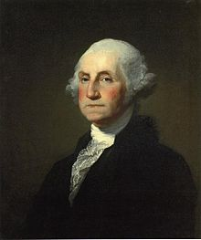
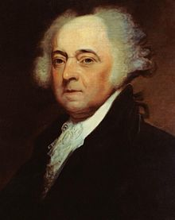
Salting Passwords
Password
Hash
d577273ff8
12345
Password
Hash
d577273ff8
12345

Slide 51
Salting Passwords
Protection against dictionary attacks and rainbow tables: Random data added as additional input to hash function
A different salt for each password – salt is readily accessible
Too many possible salts for someone to pre-compute rainbow tables & dictionary attacks also less effective
Dictionary attack: hash (attempt [i]) compared against entire table of pwds. With salting: hash (salt (user[k], attempt[k,i])
Cracking a single user’s pwd remains “easy”
Hash
Password
Salt
12345
G
4cba08af00
Password
Salt
Hash
12345
J
6e2f146823

Slide 52
Next Lecture
A Deeper dive into authentication:
Authentication protocols
Multi-factor authentication
Human considerations
Phishing
Results from recent empirical studies

Slide 53
References for this Part of the Lecture
Required Reading:
Ch. 6 in “Web Security, Privacy and Commerce”, Garfinkel, O’Reilly, 2002
Optional Readings:
“Citibank phish spooks 2-factor authentication”, http://blog.washingtonpost.com/securityfix/2006/07/citibank_phish_spoofs_2factor_1.html
Bank of America SiteKey - http://www.bankofamerica.com/privacy/sitekey/
Password cracking – Wikipedia - http://en.wikipedia.org/wiki/Password_cracking
Stuart Schechter, Rachna Dhamija, Andy Ozment, Ian Fischer (May 2007). "The Emperor's New Security Indicators: An evaluation of website authentication and the effect of role playing on usability studies" IEEE Symposium on Security and Privacy, May 2007. Retrieved on February 5, 2007. http://people.seas.harvard.edu/~rachna/papers/emperor-security-indicators-bank-sitekey-phishing-study.pdf

Slide 54
Q&A

